Slide 1

Instructions for
Programming Assignment 3
[CSED233-01] 2023 Spring, Data Structure
Minjae Jeong Seunguk Do Suhyeon Jeong Sangjun Lee Jaesik Park

Slide 2
Overview
Programming Assignment Guidance
How to submit your code

Slide 3
Programming Assignment Guidance

Slide 4
Overall process
Provided for the students
pa3.cpp
evaluate.cpp
NOT provided for the students
void task1() {
//do something
}
void task2() {
// implement code
}
don’t change anything here
/*
read answer.txt
read submit.txt
then compare
*/
real_test cases
real answer.txt
compile & execution
compile & execution
this will be your actual score :)
answer.txt
submit.txt
compare &
tell your score
[Task1]
…
[Task2]
…
[Task1]
…
[Task2]
…
you can self-check if your implementations are correct with the provided files

Slide 5
Programming Assignment 3 guidance
Implement your code at sort.h, sort.cpp, bst.h, bst.cpp, dabst.h, dabst.cpp, avl.h, avl.cpp, b_tree.h, b_tree.cpp, mst.h, mst.cpp for remaining tasks.
You are not allowed to change the other files: utils.h, utils.cpp, evaluate.cpp

Slide 6
Programming Assignment guidance
5. When you are done, compile and run pa2.exe
Repl.it user: type as below in terminal
CLion user: type as below in terminal, refer to the link for opening the terminal
** note that you need to specify the compiler version to 11 by -std=c++11
6. Step5 will generate submit.txt file which contains your answer
>> g++ -std=c++11 pa3.cpp utils.cpp sort.cpp dabst.cpp avl.cpp b_tree.cpp mst.cpp tree.cpp -o pa3.exe
>> ./pa3.exe
< running this will generate submit.txt
< running this will generate pa3.exe

Slide 7
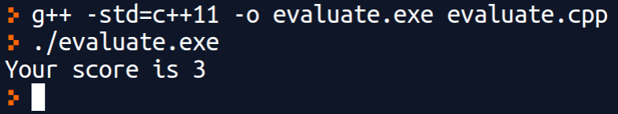
Programming Assignment guidance
7. check your score by running evaluate.cpp file. This will compare your answer submit.txt with the provided answer answer.txt.
Repl.it & CLion
note that this is not your actual score since we might use other test cases from what we’ve provided

Slide 8
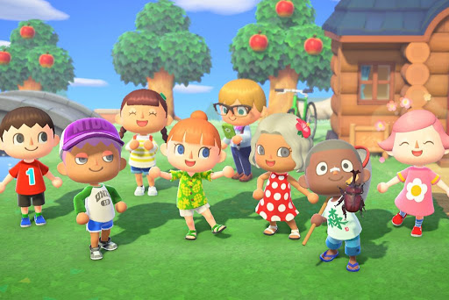
Try TODAY!
Even if the process looks not familiar to you, that is normal.
If you are not sure, please use Q&A or discuss it with your friends.
Animal Crossing, © Nintendo

Slide 9
How to submit your work

Slide 10
Via POSTECH-LMS
Go to PLMS(https://plms.postech.ac.kr/) → CSED233-01 → Learning activity → assignments
Put your pa3.cpp, tree.h, tree.cpp, sort.cpp, bst.h, bst.cpp, dabst.h, dabst.cpp, avl.h, avl.cpp, b_tree.h, b_tree.cpp, mst.h, mst.cpp file and pa3.exe in single folder and compress it into a zip file
The name of zip file should be : studentNumber_YourName.zip (e.g : 20231234_HongGildong.zip)
Submit your zip file!
Please be aware... we won’t accept email submissions

Slide 11
Q&A

